Slide 1
Simulating Adiabatic Parcel Rise
Presentation by Anna Merrifield, Sarah Shackleton and Jeff Sussman
Notes:
SARAH

Slide 2
Buoyancy Force
Relationship of parcel density to atmospheric density
At a given pressure, density is determined by Temperature
Notes:
JEFF
If Tparcel<Tenv environment is stable.
If not, unstable
When parcel is warmer than env, unstable b/c less dense than surrounding environment so will continue to rise.
Point in atmosphere where parcel is first unstable is the Level of Free Convection (LFC)
Parcel rises and is unstable until reaches another point of equilibrium: Level of Neutral Buoyancy (LCL)

Slide 3
Buoyancy Force
If the parcel is less dense (warmer) than the atmosphere it will rise adiabatically and cool
T’ > T_{env}
If parcel is more dense (cooler) than the environment it will sink adiabatically and warm
T’ < T_{env}
Notes:
JEFF
Adiabatic: no heat added/taken away
Warming/cooling comes from expansion/compression of the parcel
The less dense parcel is warmer, and will rise adiabatically, expand and cool until the parcel temperature is equal to the environment temperature.
-Opposite occurs when the parcel is cooler, more dense.

Slide 4
Real World Examples of Parcel Rise
Cloud formation
If the environment is stable, clouds that form will be shallow (stratus clouds)
In an unstable environment, vertical motion occurs, cumulus and cumulonimbus form
Thunderstorms/Tornadoes
With enough parcel rise, thunderstorms can form
Notes:
JEFF
Parcel rise is required for thunderstorm formation
With enough parcel rise thunderstorms can become severe/produce tornadoes
Amount of parcel rise is a good basis for potential for thunderstorm formation

Slide 5
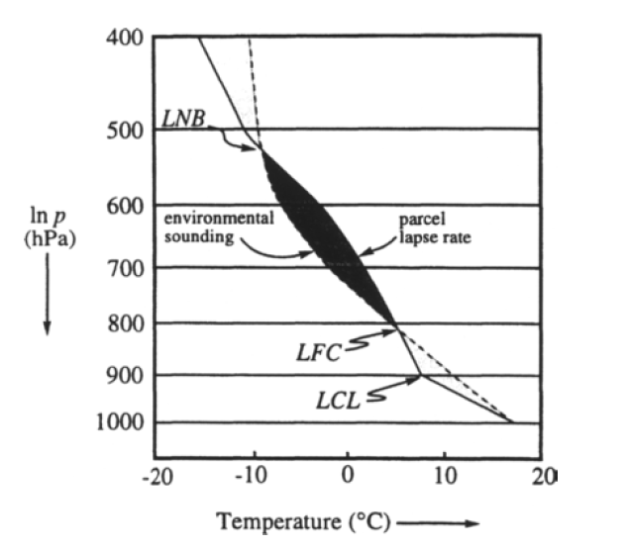
Notes:
SARAH
Discuss the process of air parcel rise in the context of the diagram, formation of CAPE, dry to saturated adiabats, and the LCL, LFC, and LNB. How log scaled P is proportional to depth

Slide 6
CAPE
Convective available potential energy
Amount of potential energy available for parcel rise
Important for thunderstorm growth/formation
Notes:
JEFF
CAPE is a measure of buoyancy and the ability of a a parcel to rise.
CAPE begins at the LFC, ends at the LNB
More CAPE= more energy available, faster velocity of parcel rise when the PE transferred to KE
Typically:
<1000 J/kg = stable atmosphere ( in very stable cases, there is no CAPE)
~2000 J/kg threshold for likely thunderstorm formation.
>3000J/kg risk for severe thunderstorms
Note on signs in Equations: in first one: Z(LFC)>Z(LNB) so produces a negative sign there

Slide 7
Parcel Method
The parcel does not mix with the surrounding environment
The parcel does not disturb its environment
The pressure of the parcel adjusts instantaneously to its environment
The parcel moves isentropically
Notes:
SARAH
We follow these assumptions in our first model, and allow for mixing with the environment in the second

Slide 8
The Model
Obtain the data from Figure 7.2 using DataThief
Determine Z(P,T)
Model Parcel Temperature assuming:
Dry adiabatic rise to LCL
Saturated adiabatic rise to LNB
“Moist” adiabatic rise above the LNB
Model Parcel Temperature assuming:
Dry adiabatic rise to LCL
Saturated adiabatic rise while entraining dry air to LNB
“Moist” adiabatic rise above the LNB
Sensitivity analysis: find lapse rates that reproduce the model
Notes:
ANNA –
Here is an overview of the model.
Figure 7.2 gives the temperature profiles of a parcel and its environment (sounding)
One of the challenges was the profiles were both given without altitude, usually a measurement consists of T and P at height Z
Above the LNB it was clear the parcel was not governed by a dry adiabat so we deteremined the most appropriate value of this lapse rate through sensitivity analysis.
Sensitivity analysis – varying values of esat to get onto the saturated adiabat (T depends on esat)

Slide 9
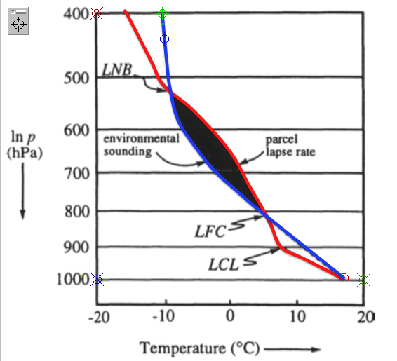
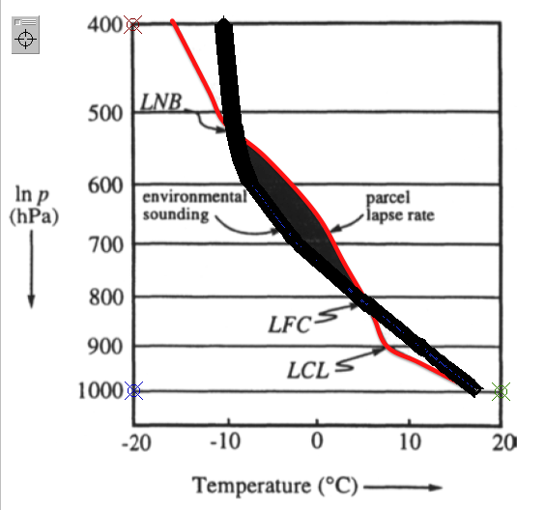
1. Obtaining the Data
The plot lines were redrawn in color to allow for effective tracing. Markers indicate the axes and the beginning, color, and end of the line we want to trace.
After the line is traced, the program picks points on the line and the data can be output and read into Matlab.
Notes:
ANNA

Slide 10
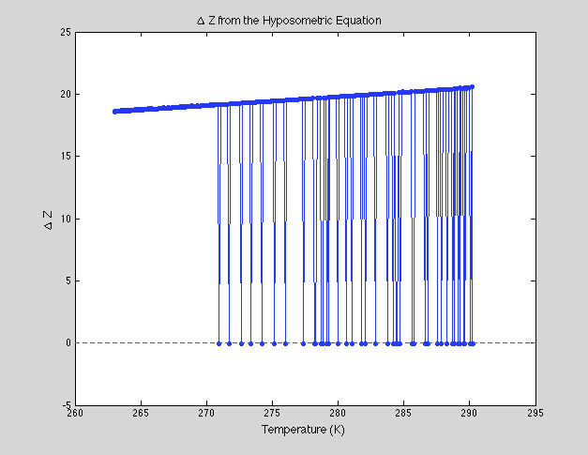
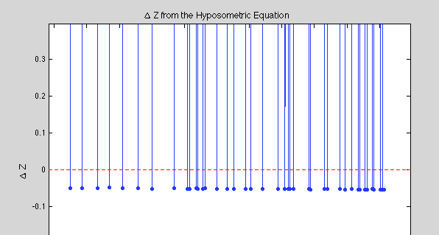
1. Problems with DataThief
Solution: Rather than throwing out points (they aren’t “bad”, we determined Z using a linear least-squares fit to 3 regions of constant lapse rate
Notes:
ANNA

Slide 11
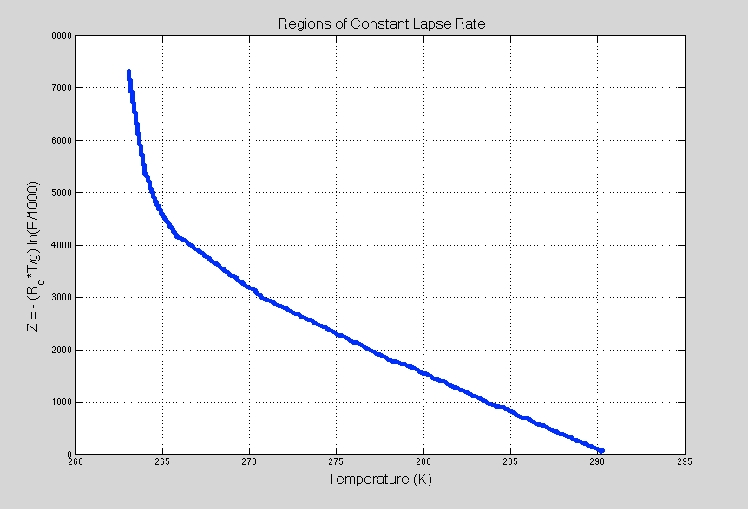
2. Determining Z(P,T)
Γ = .64 K/Km
Γ = 3.6 K/Km
Regions of ~Constant Lapse Rate
Γ = 6.5 K/Km
Notes:
ANNA

Slide 12
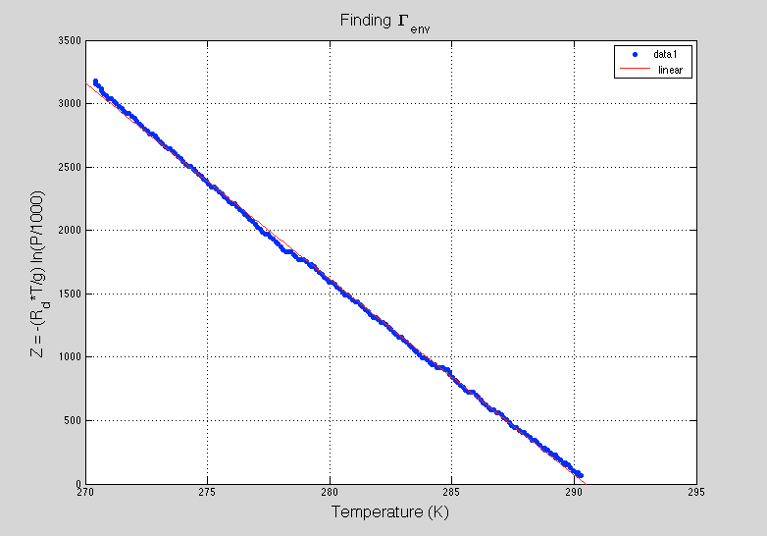
2. Determining Z(P,T)
Notes:
ANNA

Slide 13
Dry & Saturated Adiabatic Lapse Rates
Dry lapse rate: assumptions – ideal gas, atmosphere is in hydrostatic equilibrium, no water vapor
Saturated lapse rate: assumptions – no loss of water through precipitation, only liquid and vapor phases, system at chemical equilibrium, and heat capacities of liquid and water vapor are negligible, parcel has reached 100% relative humidity
Notes:
SARAH
Explain why a saturated lapse rate has a smaller magnitude than a dry one – latent heat released through condensation of water vapor reduces the magnitude of the temperature change that is due to its adiabatic expansion

Slide 14
Modeling Saturated Adiabatic Rise
1. Initialize e_{sat}(1), T_{parcel} (1)
Notes:
ANNA

Slide 15
3. Model Parcel Temperature (No Entrainment)
LNB
Γ to LCL | 9.8 K/Km
Γ at LCL | 5 K/Km
Γ at LNB | 7.5 K/Km
Γ above LNB | 3 K/Km
LCL
Notes:
ANNA

Slide 16
The Second Model
Entrainment: The mixing of the rising air parcel with the surrounding environment
Entrainment rate: 1/m dm/dz
Assumptions: entrainment of dry air, constant entrainment rate, isotropic entrainment
Notes:
SARAH

Slide 17
4. Model Parcel Temperature (Entrainment)
λ (1/m) | Γ_{m} at LCL (K/Km) | Γ_{m} at LNB (K/Km)
5*10⁻¹⁰ | 5.0 | 7.5
5*10⁻⁵ | 5.4 | 7.4
1*10⁻⁴ | 5.7 | 7.2
5*10⁻⁴ | 8.6 | 4.8
Notes:
ANNA

Slide 18
Discussion
Lack of CAPE in all models
Limitations of the simplified model
Parcel movement adiabatic and reversible (no precipitation)
Entrainment of dry air
Sounding given as lnP versus T, not given with altitude which then needed to be derived using assumption of constant lapse rate atmosphere in three regions
DataThief does not give monotonically increasing data points
Notes:
ANNA and SARAH

Slide 19
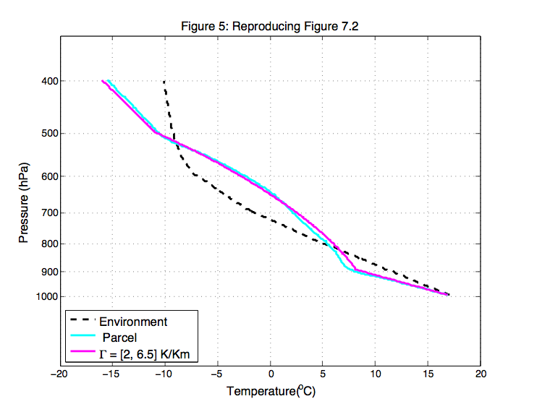
5. Reproduction of Figure 7.2
Γ to LCL | 9.8 K/Km
Γ at LCL | 2 K/Km
Γ at LNB | 6.5 K/Km
Γ above LNB | 3 K/Km
LNB
LCL
Notes:
ANNA – esat to get on that adiabat ~ 40 cooresponds to T= 30 ^o C, we are at 11^C

Slide 20
Summary of Lapse Rates
 | Environment | No Entrainment | λ = 5*10^-10 1/m | λ = 5*10^-5 1/m | λ = 1*10^-4 1/m | λ = 5*10^-4 1/m | Best Reproduction | Approximate Parcel
Γ to LCL | 6.5 | 9.8 | 9.8 | 9.8 | 9.8 | 9.8 | 9.8 | 10.9
Γ at LCL | 6.5 | 5.0 | 5.0 | 5.4 | 5.7 | 8.6 | 2.0 | 3.1
Γ at LNB | 0.64 | 7.5 | 7.5 | 7.4 | 7.2 | 4.8 | 6.5 | 6.1
Γ above LNB | 0.64 | 3.0 | 3.0 | 3.0 | 3.0 | 3.0 | 3.0 | 3.1
Notes:
ANNA Approximate parcel – parcel linearly interpolated onto z, saturated section is nonlinear (20 point range fits)

Slide 21
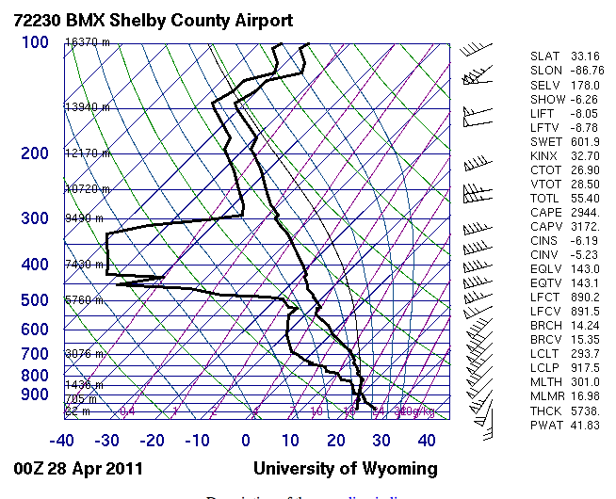
Example sounding
Notes:
JEFF
Sounding from 0Z April 28,2011. Chosen because it was right in the middle of the large tornado outbreak in the Southeast US from April 25-28. The sounding is unstable almost from the surface, and very little CINE is present. Additionally, dry air which will be discussed more later is present at the 300-500 mb level. This dry air is the result of a strong westerly jet that can be seen in the wind profile on the right.

Slide 22
CAPE example with entrainment
Image from NWS from Amarillo, TX, July 22,2013
Notes:
JEFF
Note: this slide might be best towards the end
Entrainment has 2 major effects:
1. Makes rising parcel more stable: evaporational cooling, so parcel cools, closer to atmospheric temp, less buoyant
2. Makes sinking parcel even more stable, so will be even cooler, sink faster: this forms strong downdrafts in thunderstorms.
Why I chose this sounding:
Example of entrainment of dry air from actual sounding where dry air is very noticeable at two levels
Two noticeable layers of dry air here
Dry air can be seen where dew point is very low (so air would have to cool a lot to be saturated)
If the dry air at the base is entrained, will lower CAPE on the way up, so parcel wont rise as much
If dry air higher up is entrained, possibly through falling rain, this cooling of parcel on the way down will increase negatively buoyancy so parcel will fall fast = stronger downdrafts
Also a good example of what presence of dry air looks like in the atmoshpere. Our model uses a constant entrainment rate, but in the atmosphere dry air is not a constant value with height.

Slide 23
Conclusions and Further Work
Failure to reproduce plot using simplified governing assumptions of adiabatic parcel rise
Further work using soundings from a database
http://weather.uwyo.edu/upperair/sounding.html
Notes:
SARAH

